Slide 1





4.12.24

Slide 2










2

Slide 3



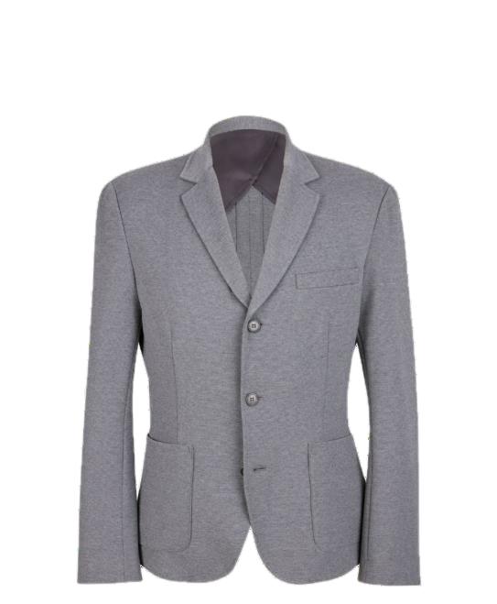
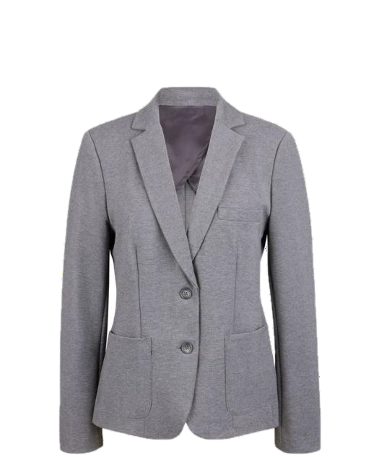
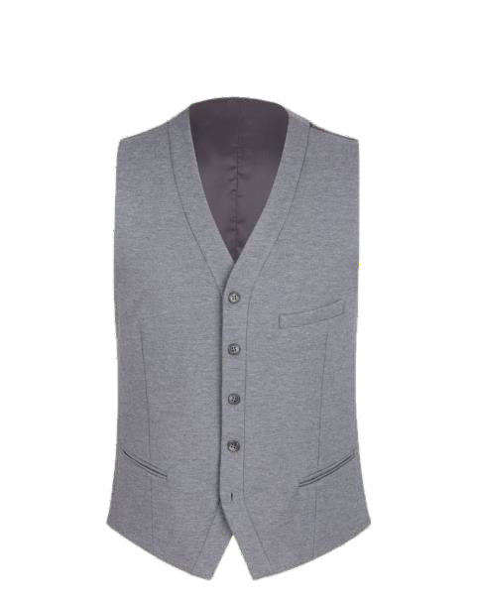

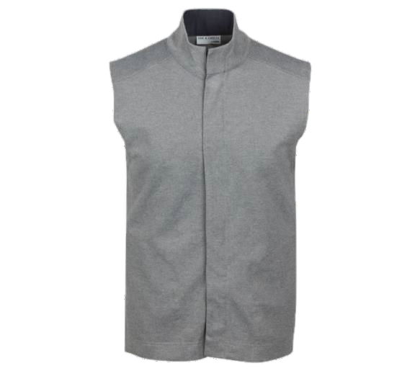


Parker Blazer (M)
115932 (20) Navy, (30) Light Grey
Warwick Blazer (F)
115933 (20) Navy, (30) Light Grey
Millstone Vest (M)
115936 (20) Navy, (30) Light Grey
Fairways Vest (U)
115845 (30) Light Grey
72% polyester/24% rayon/4% spandex
72% polyester/24% rayon/4% spandex
72% polyester/22% rayon/6% spandex
72% polyester/24% rayon/4% spandex
Single-breasted, Three-button closure, Single-breasted, Two-button closure,
Fully lined, V-Neckline with
front frame, Adjustable back belt with buckle, Five button closure, Two inner patch pockets, Front vertical waist darts, Two lower
double welt pockets, Back neck frame and princess seams, Imported
Stretch, Standing collar, Contrasting inside collar and inside placket, Fly front with zipper closure, Side pockets, Unlined,25 3/4" long,
Domestic/ Imported
Notch collar, Partially lined body and fully Notch collar, Fully lined body and fully
lined sleeves with fast-drying breathable AEROCOOL ® lining, One upper and two lower front pockets, Double back
vent, Stretch fabric, Domestic/Imported
lined sleeves with fast-drying breathable AEROCOOL ® lining, One upper and two lower front
pockets, Stretch fabric, Domestic/Imported
Unisex XS-XL, 2XL-4XL, Dry Clean or
Machine Wash Gentle
Men’s 34-48, 50-60, Dry Clean or
Machine Wash Gentle
Misses’ 0-16, Women’s 16W-30W, Dry Clean or Machine Wash Gentle
Men’s S-XL, 2XL-4XL, Dry Clean or Machine Wash Gentle
(20) (30)

Slide 4


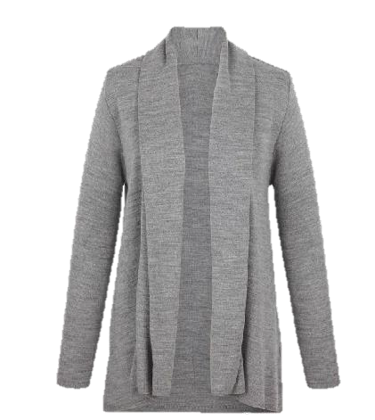
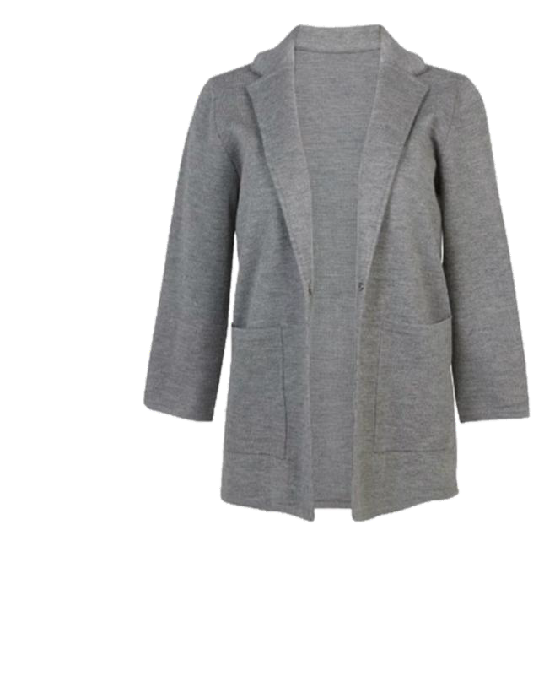
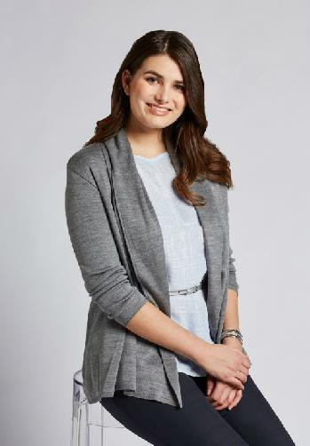




CORE PRODUCT
(Navy not included)
Open Cardigan Sweater
115853 (20) Navy, (35) Black,
(31) Heather Grey
Sweater Blazer
117900 (30) Light Grey, (33) Charcoal
100% acrylic Durapil™
100% acrylic
Notched collar, hook/bar single closure at center front, ¾- length sleeves, lower front patch pockets, clean edge finish at sleeve opening and bottom edge, Imported
Durapil™ Ultra acrylic yarn, draped front open neckline, rib-knit finish at sleeve opening and bottom hem, Imported
Misses’ XS-XL, Women’s 1XW-3XW, Machine Wash
Misses’ XS-4XL, Machine Wash
(20) (30/31) (33)
(35)

Slide 5

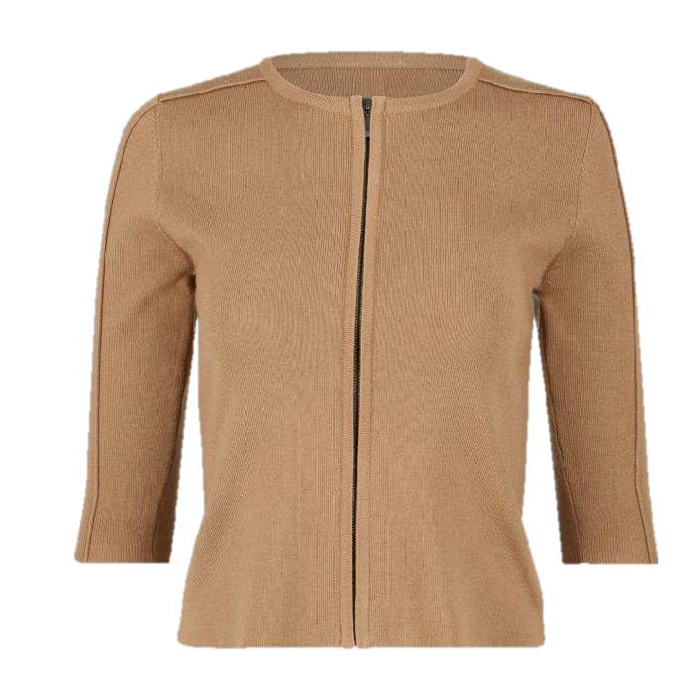
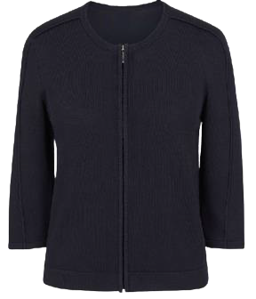
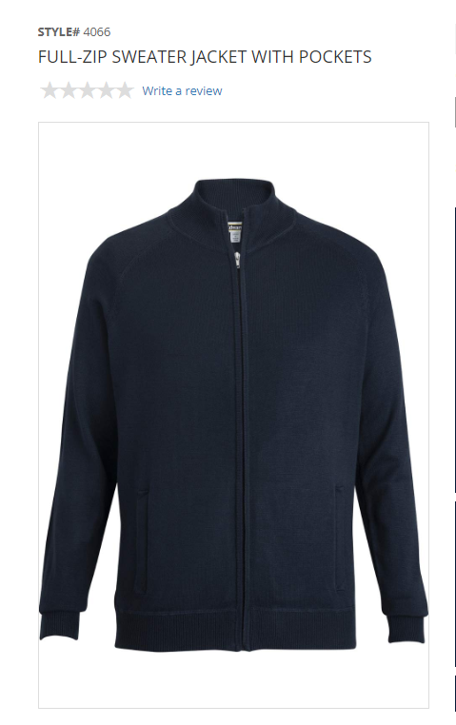
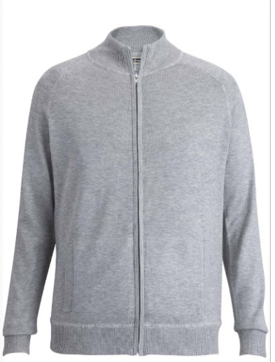
Zip Front Cardigan
116647 (30) Light Grey Heather,
(63) Camel
Zip Front Cardigan
116648 (20) Navy, (35) Black
80% viscose/20% nylon
55% acrylic/23% wool/22% nylon
¾ Sleeve, forward raised seam detail down sleeve
¾ Sleeve, forward raised seam detail down sleeve
Male Zip front sweater: available in Navy, light grey and black
Misses’ XS-XL, Women’s 1XW- 4XW, Machine Wash
Misses’ XS-XL, Women’s 1XW- 4XW, Machine Wash

Slide 6


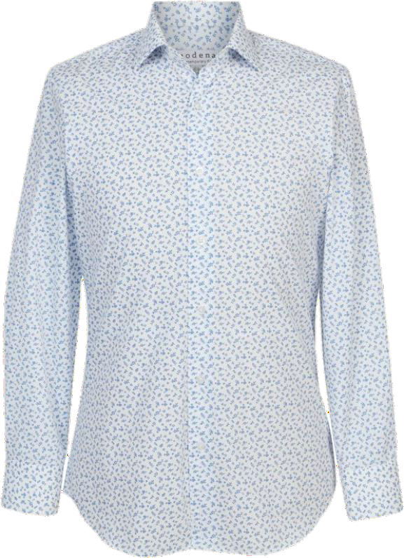

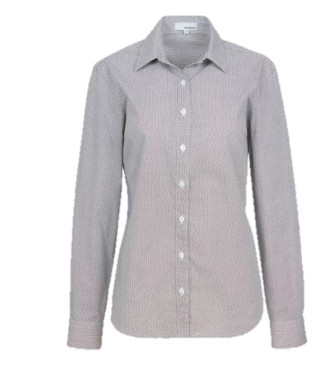
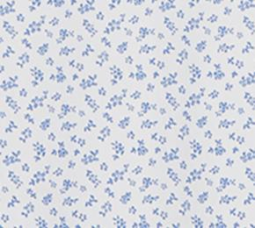




Printed Shirt – Men's
117589 (20) Blue Geo Print, (22) Blue Floral Print, (90) Black Geo Print,
(35) Black Floral Print
60% cotton/40% polyester
Shirt collar with stand button on stand, Removable collar stays, Center front 6 button
placket, Long sleeve with double pleat at cuff seam, 2 Button adjustable rounded corner cuffs, Sleeve has doghouse placket with button, Back yoke with side pleats, Felled seam at side seam
/sleeve inseams, Extra buttons attached -2 total, one of each size, Extra collar stays included
Men’s XS-4XL, Machine Wash
Printed Blouse – Women's
117590 (20) Blue Geo Print, (22) Blue Floral Print, (90) Black Geo Print,
(35) Black Floral Print
60% cotton/40% polyester
Shirt collar with stand, Button front placket, Side bust darts, Back yoke, Long sleeve
with doghouse placket with button closure, Adjustable button cuff, Back waist darts, Side slits
Women’s XS-XL, 1XW-4XW, Machine Wash
(20) (22) (35) (90)
*Enlarged to show pattern

Slide 7


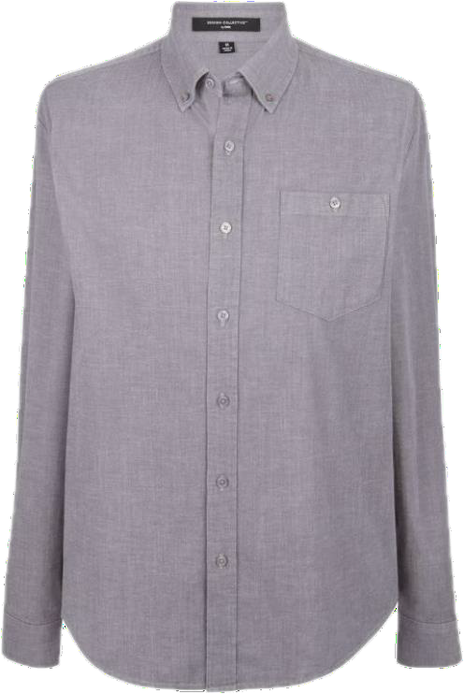
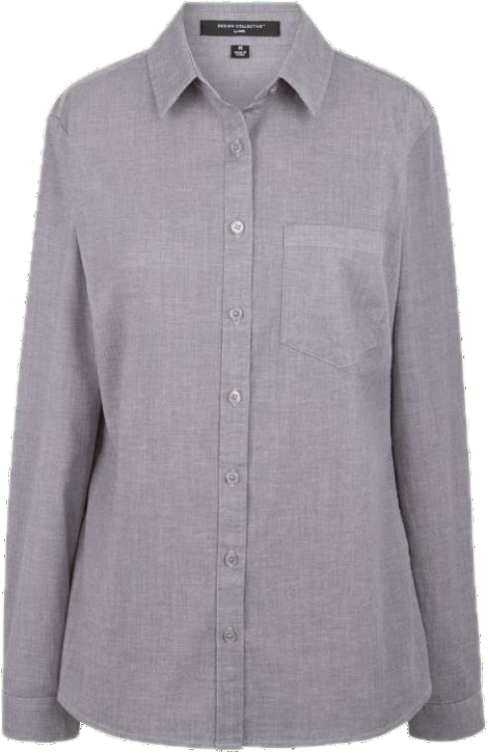


Chambray Shirt
118350 (22) Cobalt, (25) Indigo, (31) Pewter
60% cotton/38% Tencel/2% spandex
Button-down shirt collar with stand, Button-front placket, Wearer’s left
chest pocket with button, Double layer back yoke, Long sleeves with bound sleeve vent, Single pleat at sleeves with 2-button adjustable cuffs, Curved hem
Men’s S-5XL, Machine Wash
Chambray Blouse
118349 (22) Cobalt, (25) Indigo, (31) Pewter
60% cotton/38% Tencel/2% spandex
Shirt collar with stand, Button front placket, Side bust
and back waist darts, Back yoke, Adjustable sleeve tab with button, Adjustable button cuff, Side slits, Shirt tail shaped hem
Misses XS-XL, Women’s 1XW-4XW, Machine Wash
(22)
(25)
(31)

Slide 8




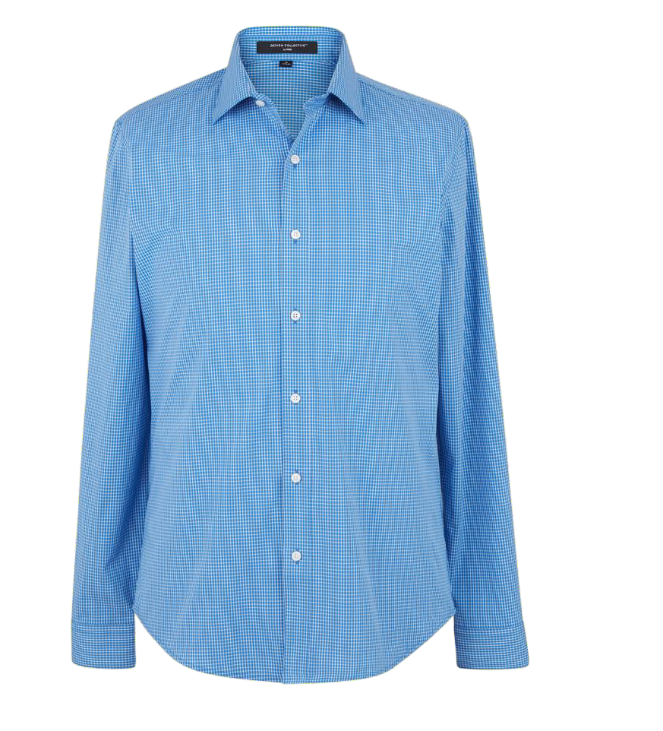
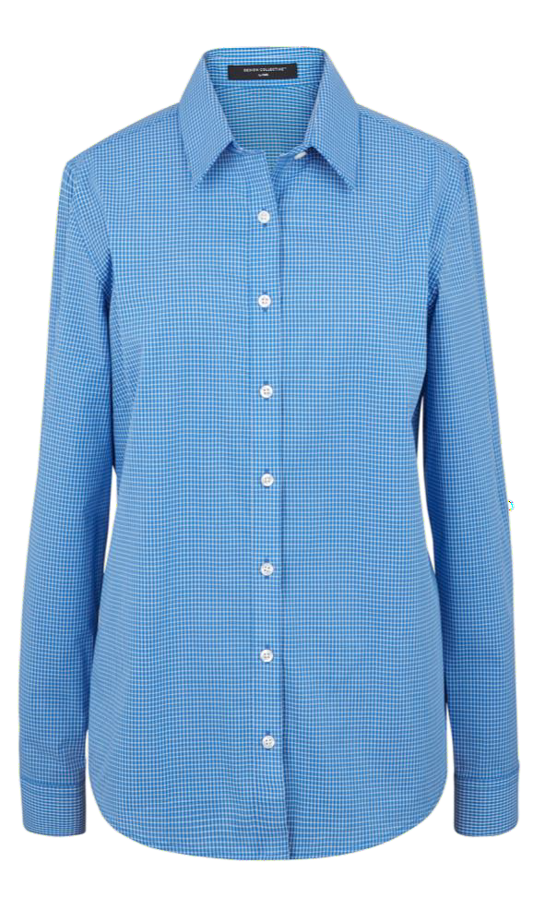

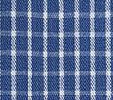



Mini-Check Shirt
118248 (29) Purple, (61) Oat, (32) Grey, (21) Cobalt, (15) Red
63% polyester/33% cotton/4% spandex
Spread shirt collar with stand, Removable collar stays, Long sleeve with pleat at cuff seam, Adjustable sleeve tab with button, 2 button adjustable rounded corner cuffs, Sleeve has bound placket, Back yoke with side pleats, Shirt tail shaped hem
Men’s S-5XL, Machine Wash
Mini-Check Blouse
118249 (29) Purple, (61) Oat, (32) Grey, (21) Cobalt, (15) Red
63% polyester/33% cotton/4% spandex
Shirt collar with stand, Removeable collar stays, Button front placket, Side bust and back waist darts, Back yoke, Adjustable sleeve tab with button, Adjustable button cuff, Side slits, Shirt tail shaped hem
Misses XS-XL, Women’s 1XW-4XW,
Machine Wash
(15)
(21)
(29)
(32)
(61)

Slide 9


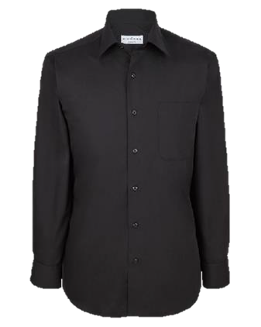
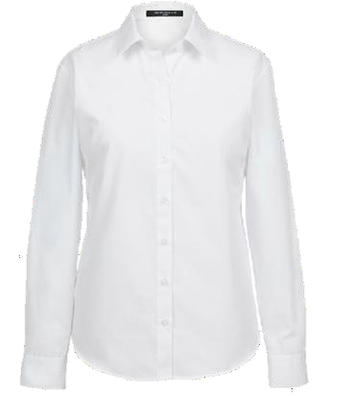







Solid Poplin Dress Shirt
115113 (01) Eggshell, (23) Powder Blue, (27) Lavender, (31) Silver, (33) Charcoal
(35) Black
Solid Poplin Blouse
115852 (00) White, (23) Light Blue, (27) Lavender,
(31) Silver, (33) Charcoal, (35) Black
60% cotton/40% polyester
Modern fit, Shirt collar with removable stays, Adjustable cuffs, Left chest pocket, Shirttail hem, Tall sizes have approximately two inches additional in the length, Big sizes have a more relaxed fit, Two extra buttons and extra collar stays included, Imported
60% cotton/40% polyester
Modern fit, Shirt collar with removable stays, Adjustable cuffs, Shirttail hem, Two extra buttons and extra collar stays included, Imported
Men’s Half Sizes:
Neck 14H-17H; Sleeve 32/33, Neck 15H-22H; Sleeve 34/35, Neck 16H-22H; Sleeve 36/37
(Updated Design Collective sizing from 115263):
Misses’ XS-XL, Women’s 1XW-4XW, Machine Wash
Machine Wash
(00)
(01)
(23)
(27)
(31)
(33) (35) (80)

Slide 10


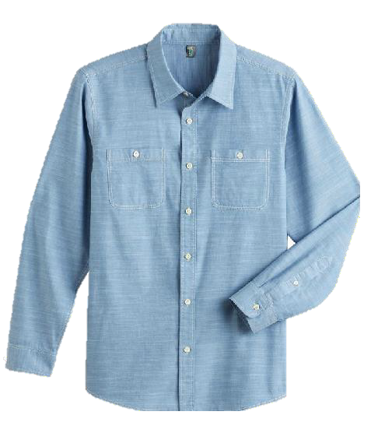
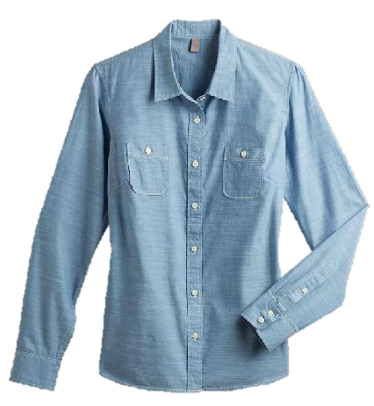
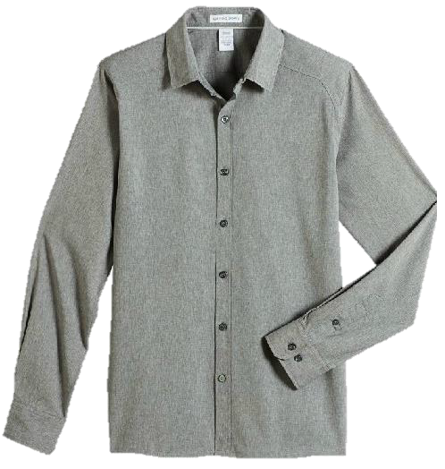
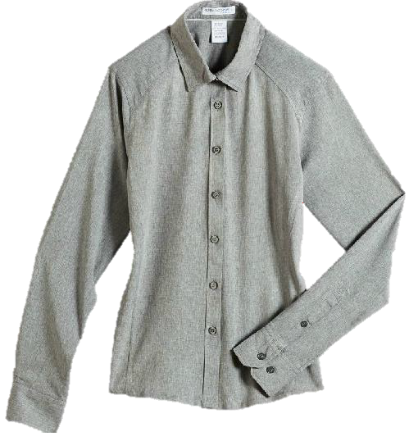


Chambray Shirt
115721 (80) Light Blue, (32) Grey,
(20) True Navy
Chambray Blouse
115722 (80) Light Blue, (32) Grey,
(20) True Navy
Melange Shirt
115402 (31) Light Grey
Melange Blouse
115403 (31) Light Grey
100% polyester
100% polyester
100% cotton
100% cotton
Polyester mechanical stretch two-
tone mélange, Modern fit, Button front closure, Hidden button-down collar,
Double-needle flat felled side and underarm seams, Tailored adjustable cuffs with buttoned sleeve plackets, Back yoke with side pleats, Imported
Men’s S-3XL, Machine Wash
Polyester mechanical stretch two-tone mélange, Modern fit, Button front closure, Hidden button-down collar, Double-needle flat felled side and underarm seams, Tailored adjustable cuffs with buttoned sleeve plackets, Back yoke with side pleats, Imported
Ring spun combed cotton chambray, Shirt collar, Button-down front closure, Two front patch pockets, Two button adjustable cuff, Two back pleats at yoke, Imported Men’s XS-4XL, Machine Wash
Ring spun combed cotton chambray, Shirt collar, Button-down front closure, Two front patch pockets, Two button adjustable
cuff, Back princess seams, Imported
Misses’ XS-4XL, Machine Wash
Misses’ XS-3XL, Machine Wash
(20)
(31)
(32)
(80)

Slide 11
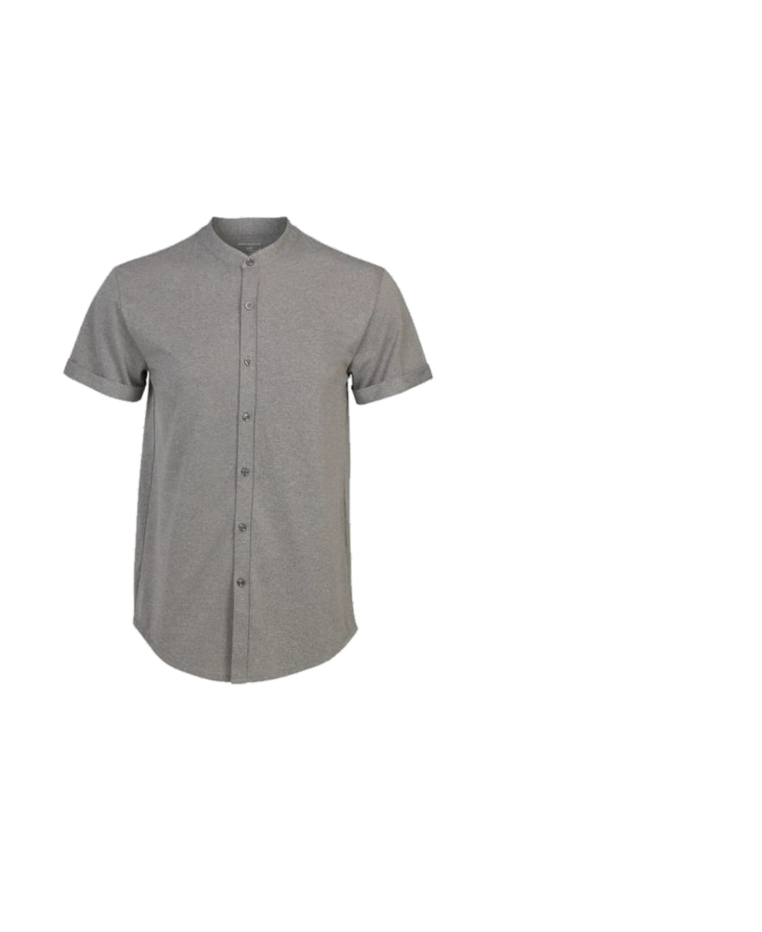

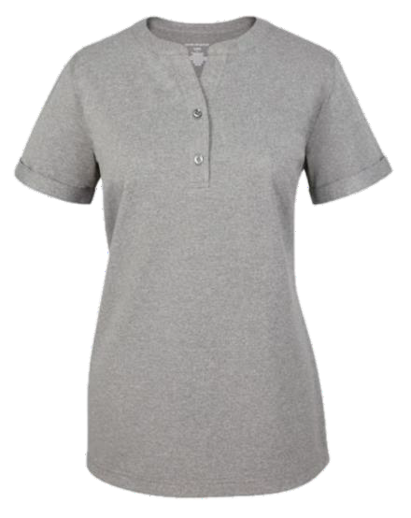

Male Banded Collar Knit
117191 (32) Grey Heather
100% polyester
Hybrid polo/woven shirt in comfort knit, Banded collar, Front fold-
back button placket, Short sleeve with rolled hem, Shirt tail hem, Back yoke, Back waist darts for slight shaping
Men’s S-5XL, Machine Wash
Female Banded Collar Knit
117192 (32) Grey Heather
100% polyester
Hybrid polo/woven shirt in comfort knit, Banded collar, Front placket with 2 buttons, Bust darts, Short sleeve with rolled hem, High/low hem,
Side vents, Back yoke, Back waist darts for slight shaping
Misses’ XS-XL, Women’s 1XW-5XW, Machine Wash
(32)

Slide 12


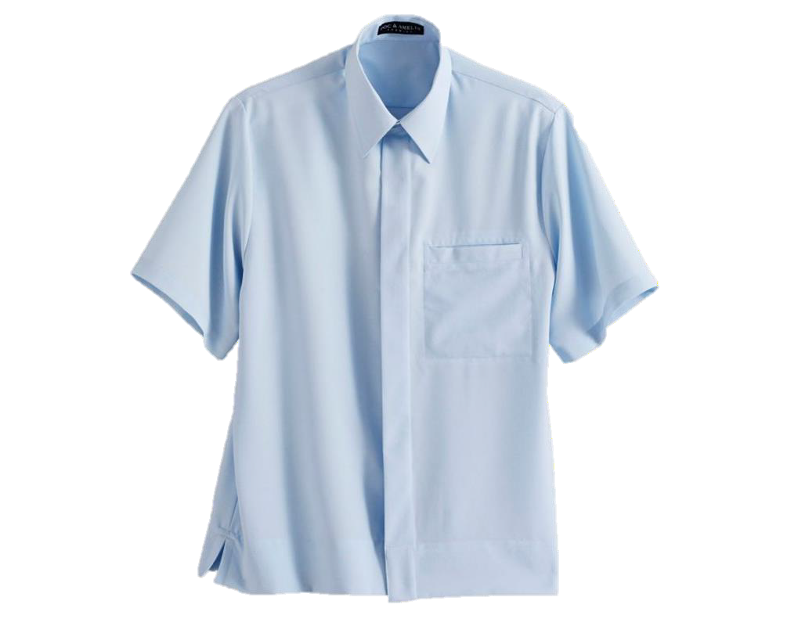
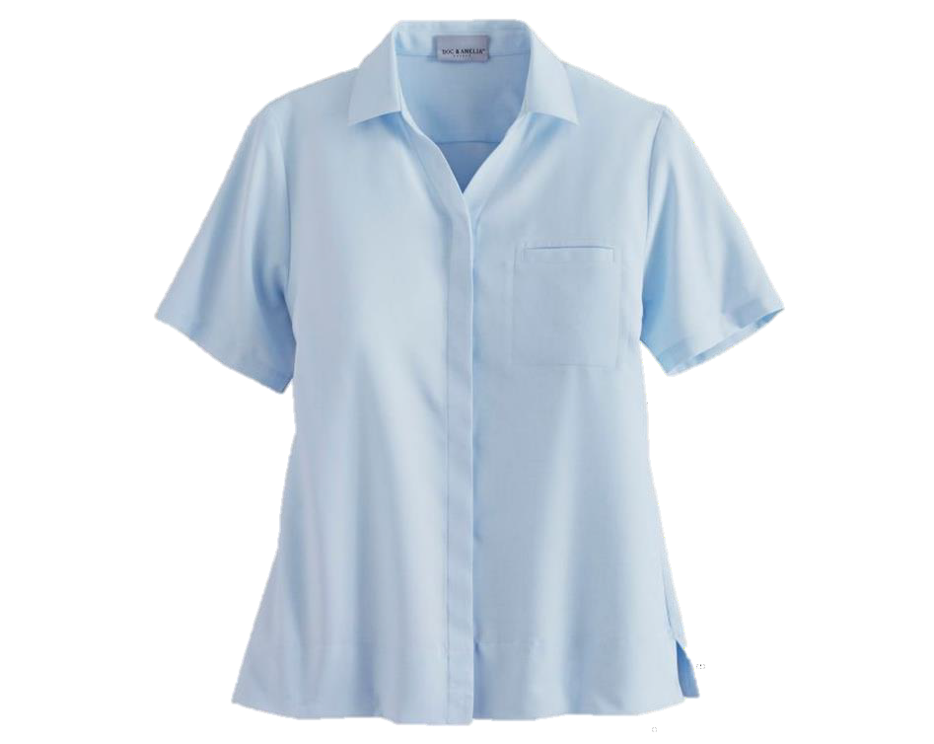







Can add accent colors to pocket to create signature look
Fusion Fly-Front Camp Shirt
60834 (18) Paprika, (22) Cobalt, (23) Light Blue, (33) Charcoal, (61)
Buff, (90) Black, (99) Silver
Fusion Fly-Front Camp Blouse
60841 (18) Paprika, (22) Cobalt, (23) Light Blue, (33) Charcoal, (61) Buff,
(90) Black, (99) Silver
100% polyester
100% polyester
(18)
(22)
(23)
Moisture wicking fabric with soil-release finish and mechanical stretch, Fly-front placket with dyed-to-match buttons, Left chest pocket, Straight bottom hem with side vents, One extra button included, Imported
Moisture wicking fabric with soil-release finish and mechanical stretch, Fly-front placket with dyed-to-match buttons, V-neckline, Left chest pocket, Straight bottom hem with side vents, One extra button included, Imported
(33)
(61)
(90)
(99)
Men’s S-XL, 2XL-4XL*, Machine Wash
Misses’ XS-XL. Women’s 1XW-4XW*, Machine Wash

Slide 13


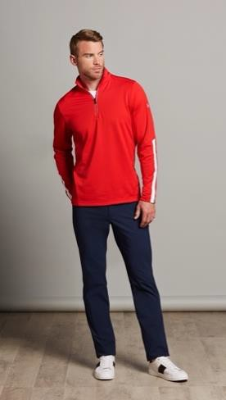
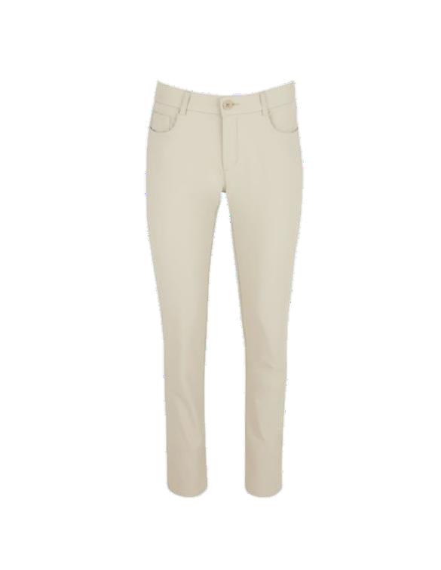




Tech Pant
116549 (20) Ink, (33) Pewter, (35) Black, (62) Khaki
CORE PRODUCT
(Black only)
97% nylon/3% spandex
5 pocket pant styling, 2 front scoop pockets with mesh pocket bags, Waistband with internal elastic, Fly front, Left leg seam pocket with invisible zipper
Men’s 28-50, Machine Wash
Tech Slack
116550 (20) Ink, (33) Pewter, (35) Black, (62) Khaki
97% nylon/3% spandex
5 pocket pant styling, 2 front scoop pockets with mesh pocket bags, Waistband with internal elastic, Fly front, Left leg seam pocket with invisible zipper
Misses’ 0-16, Women’s 16W-24W, Machine Wash
(20)
(33)
(35)
(62)

Slide 14


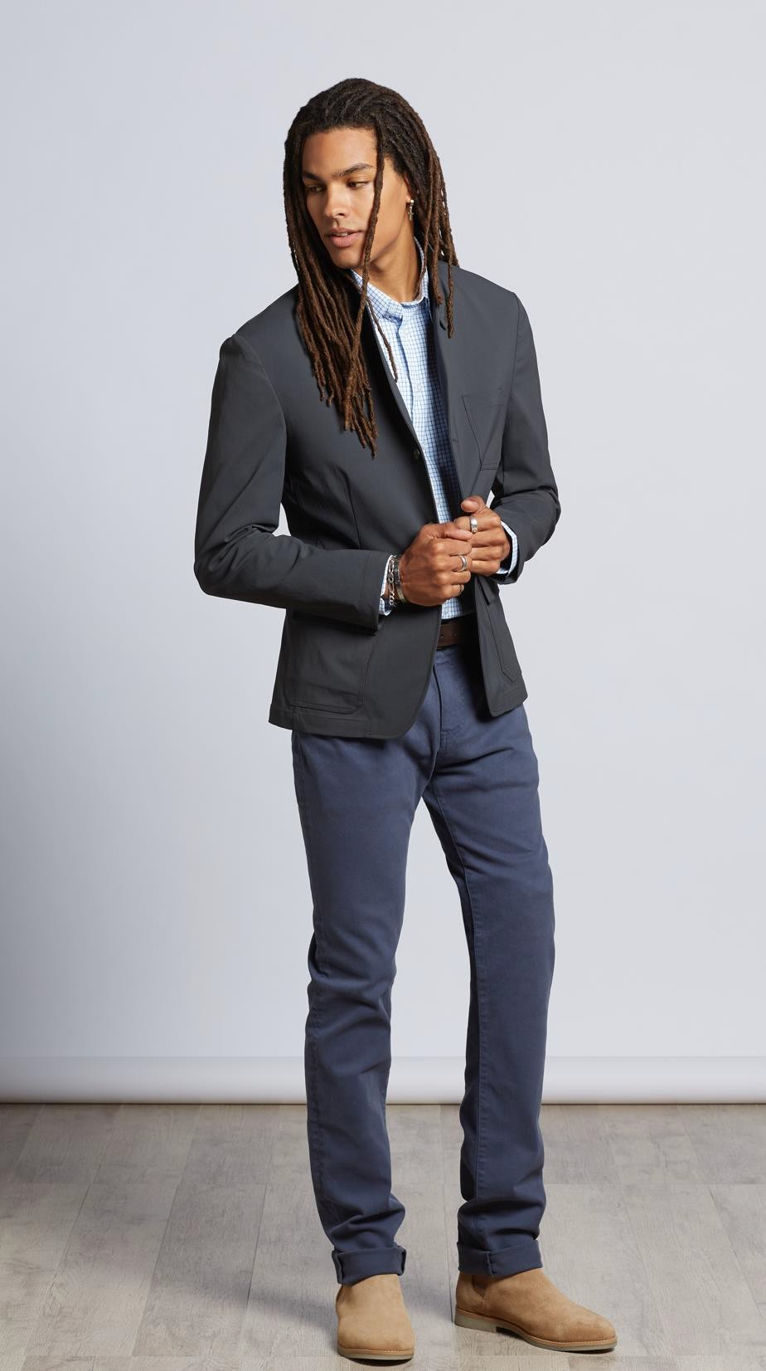
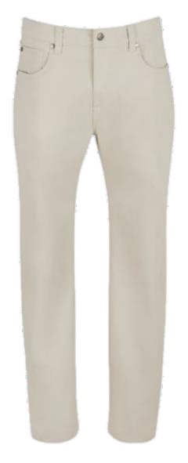
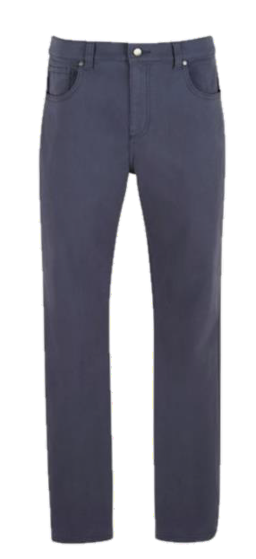



Denim Twill Male Pant
116747 (63) Sand, (00) White, (21) Aero Blue
98% cotton / 2% elastane
Stretch
Regular fit jean, Button front zip fly, Five pockets: Two front, Right coin, Two
back, Imported
Men's 28-50, Machine Wash
Denim Twill Female Slack
116748 (63) Sand, (00) White, (21) Aero Blue
98% cotton / 2% elastane
Stretch
Reg inseam 32", Long inseam 34", Short inseam, 30“, Skinny leg fit jean,
Button front zip fly, Five pockets: Two front, Right coin, Two back, Imported
Missy 0-16 Reg, Short, Long, Women’s 18W-34W Reg, Short, Long, Machine
Wash
(00) (21) (63)

Slide 15


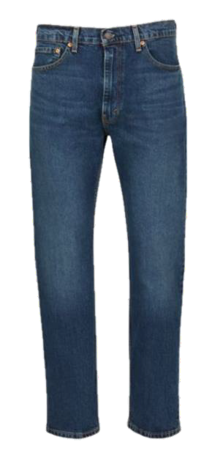


Levi's Male 505 Straight Jeans
115788 (35) Black, (83) Dark Blue
100% cotton
Sits at the waist, Extra room in the thigh,
Straight leg, Imported
Men’s 29-40, 42-50, Machine Wash
(35)
(83)

Slide 16

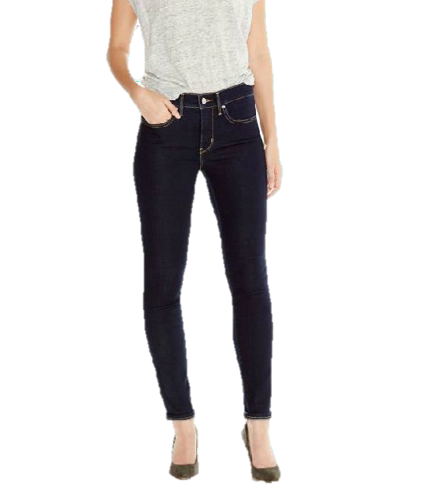
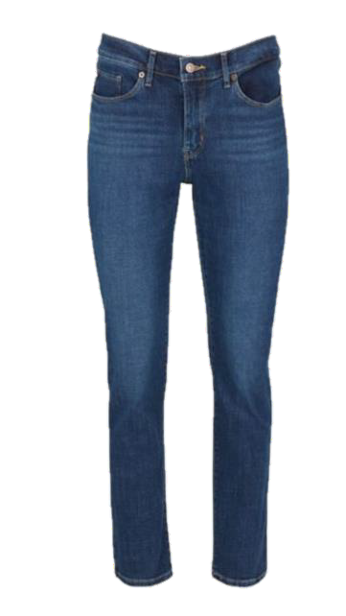

Levi's 311 Shaping Skinny Jeans
118312 (25) Dark Blue, (35) Black
Levi's Female 505 Straight Jeans
115785 (35) Black, (83) Dark Blue
81% cotton/17% polyester/2% elastane
81% cotton/17% polyester/2% elastane
Skinny leg jean, Tummy-slimming panel, Levi's® Sculpt Fabrication with Hypersoft for enhanced comfort with supportive stretch, Zip fly, Button waistband
Zip-fly with button closure, Five pocket styling, Straight fit through hips and thighs, Straight leg, Short length = 28“, Regular length = 30“, Long length = 32“, Imported
Ladies’ 24-34 (various inseams offered 28-
32), Machine Wash
Misses’ Short 4-18, 20-24, Machine Wash
(25)
(35)
(83)

Slide 17

17

Slide 18



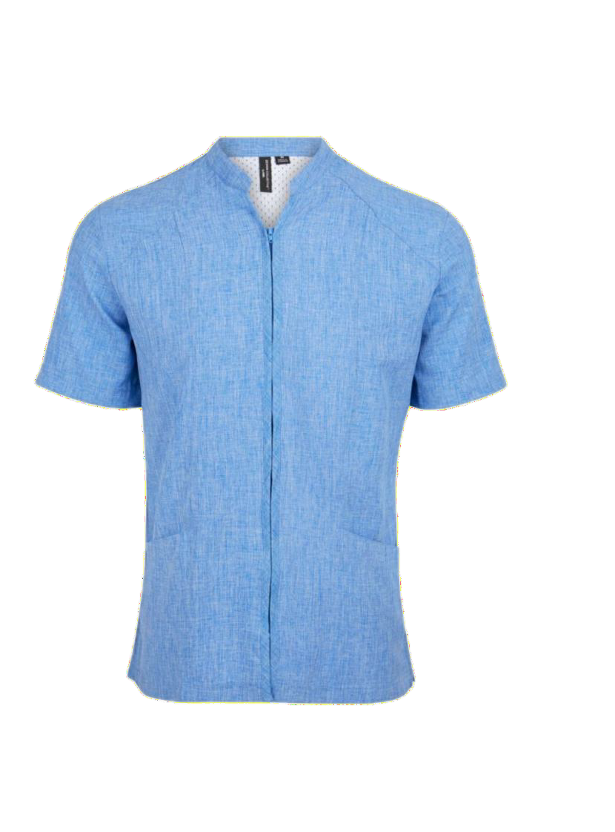
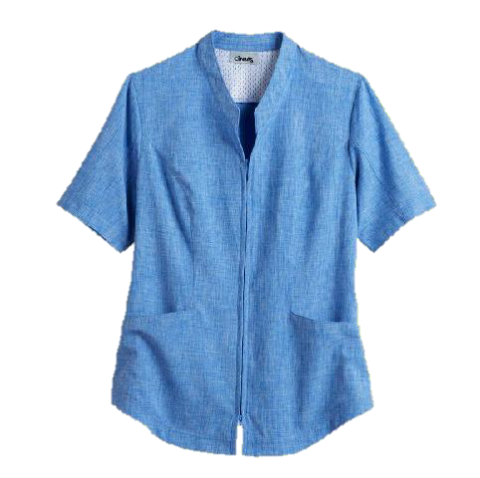




CORE PRODUCT
(M/F Blue and Grey only)
Effortflex Zip Front Shirt
115831 (20) Blue, (62) Khaki, (16) Raspberry, (33) Grey
100% polyester
Heathered, Moisture management, Mechanical stretch, UPF30, Stand collar,
Front seaming, Two lower front on seam pockets, Loop on left pocket, Back yoke with mesh panel, Imported
Men’s S-XL, 2XL-5XL, Machine Wash
Effortflex Zip Front Tunic
115830 (20) Blue, (62) Khaki, (16) Raspberry, (33) Grey
100% polyester
Heathered, Moisture management, Mechanical stretch, UPF30, Stand collar,
Front seaming, Two lower front on seam pockets, Loop on left pocket, Back yoke with mesh panel, Imported
Misses’ XXS-XL. Women’s 1XW-5XW, Machine Wash
(16)
(20)
(33)
(62)

Slide 19



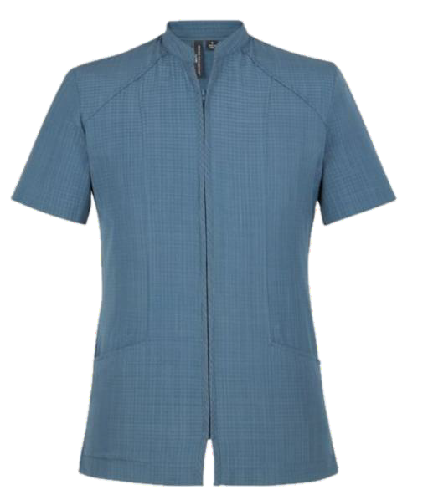
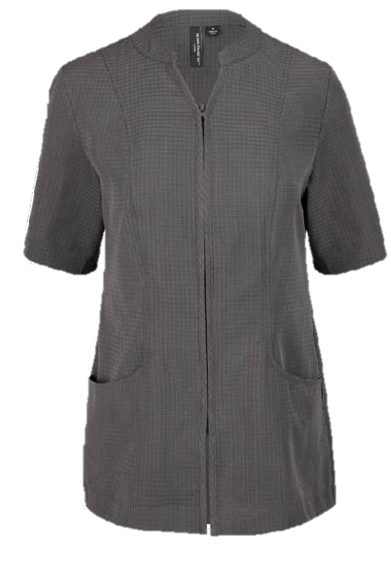


CORE PRODUCT
(M/F Indigo only)
Evolution Air Zip Front Shirt
116485 (33) Charcoal, (24) Indigo
100% polyester
Zip front, Two lower front angled pockets, Side seam slits with 1/4" topstitch, Imported
Men’s S-XL, 2XL-5XL, Machine Wash
Evolution Air Zip Front Tunic
116484 (33) Charcoal, (24) Indigo
100% polyester
Zip front, Two lower front pockets, Princess seams in front, Back yoke with back seams, Back vent at side back seams, Locker loop on wearer's left side, Imported
Missy XS-XL, Woman’s 1XW-5XW, Machine Wash
(24)
(33)

Slide 20


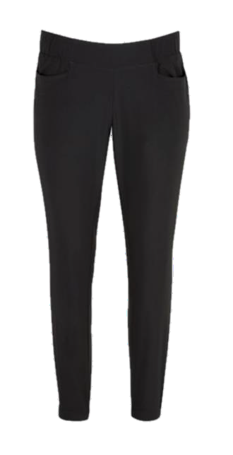
Athleisure Pant
116551 (90) Black, (33) Charcoal, (20) Navy
29-inch inseam, Unlined, Pull-on slack, Elastic waistband with flat front, Front pockets, Ankle length, Imported
Missy XS-XL, Women's 1XW-5XW, Machine Wash

Slide 21


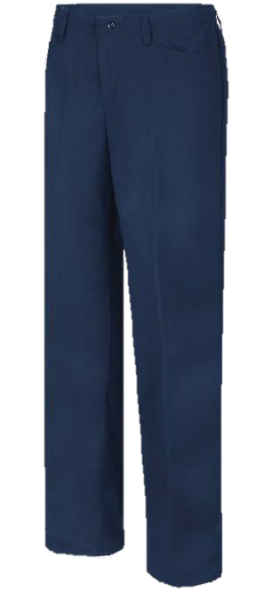
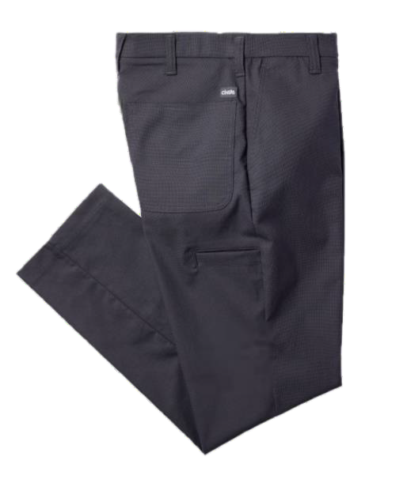
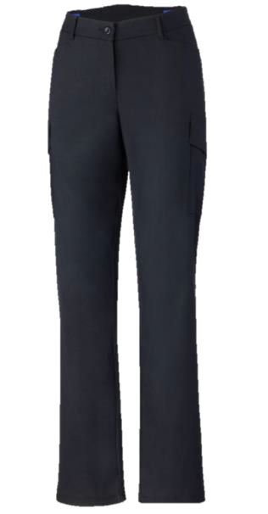
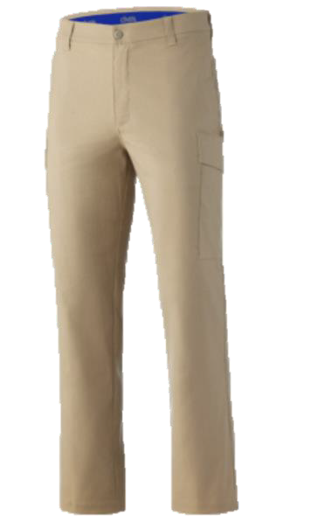




MASON STYLE
Comfort Flex Pro Work Pant (F)
023390 (20) Navy, (35) Black, (62) Khaki
Comfort Flex Pro Work Pant (M)
023945 (20) Navy, (33) Charcoal, (62) Khaki
Comfort Flex Pro Cargo Pant (F)
023389 (20) Navy, (35) Black, (62) Khaki
Comfort Flex Pro Cargo Pant (M)
023270 (20) Navy, (35) Black, (33) Charcoal, (62) Khaki
42% stretch polyester/36% bi- components/22% cotton
51% polyester/27% cotton canvas/22% polyester stretch
51% polyester/27% cotton canvas/22% polyester stretch
51% polyester/27% cotton canvas/22% polyester stretch
Interior stretch waistband for added mobility and comfort, Spacious pockets including a cell phone pocket on right leg, Gusset providing additional mobility and comfort
Stretch canvas, Durable, Lightweight, Breathable and allows for increased movement & comfort, Interior stretch waistband: Comfort and ease of movement at waist; interior only, so it is not seen from the outside, Cargo pockets
Stretch canvas, Durable, Lightweight, Breathable and allows for increased movement & comfort, 20% stretch and full recovery in a lighter weight fabric, Interior stretch waistband – comfort and east of movement of waist, Cargo pockets, Updated modern fit
Stretch twill – lightweight, breathable and allows for increased movement & comfort, interior stretch waistband – a soft-feel elastic waistband for added comfort & mobility, back welt pockets, mid-rise waist, straight leg
Men's 29-52, Machine Wash
Women’s 0-36, Machine Wash
Men's 29-52, Machine Wash
Women’s 0-38, Machine Wash
(20) (33) (35) (62)

Slide 22


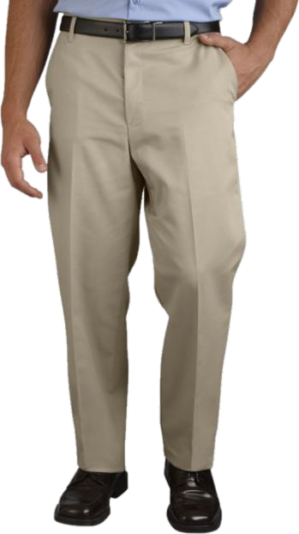
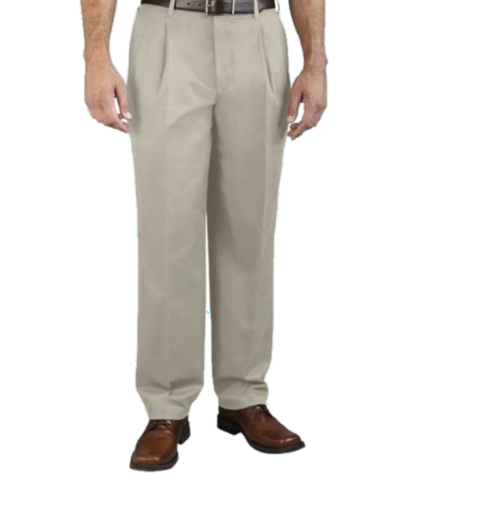







MASON STYLE
The Comfort Pant
000945 (00) White, (20) Navy, (33) Charcoal, (35) Black,
(40) Spruce Green, (50) Brown, (62) Khaki
The Comfort Pant Pleated
000865 (20) Navy, (33) Charcoal, (35) Black, (62) Khaki
65% polyester/35% cotton Cintas ComfortFLEX®
65% polyester/35% cotton Cintas ComfortFLEX®
Relaxed, roomy cut for ultimate for ultimate comfort,
Imported/Domestic
Relaxed, roomy cut for ultimate for ultimate comfort, Imported/Domestic
Men's 26-70, Machine Wash
Men's 26-70, Machine Wash
(00) (20) (33) (35)
(40)
(50)
(62)

Slide 23

23

Slide 24


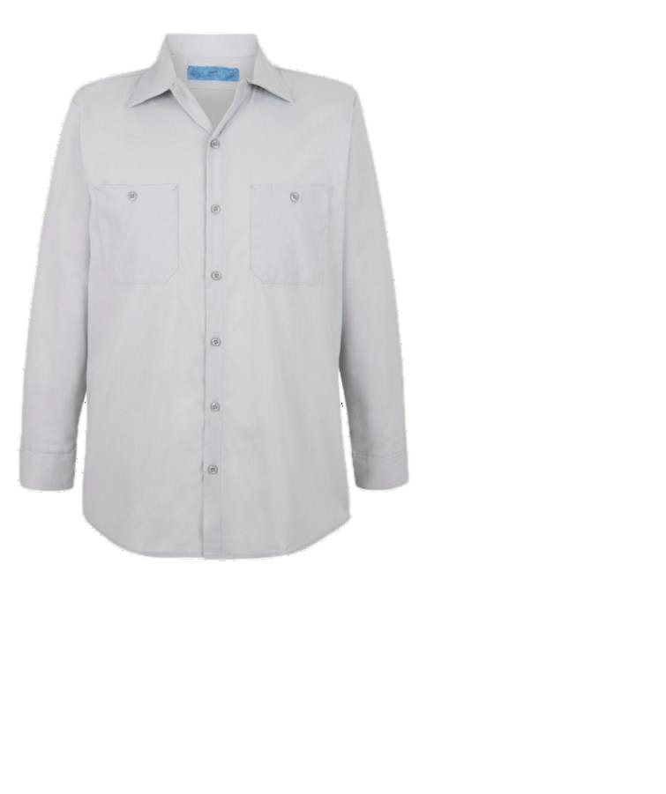
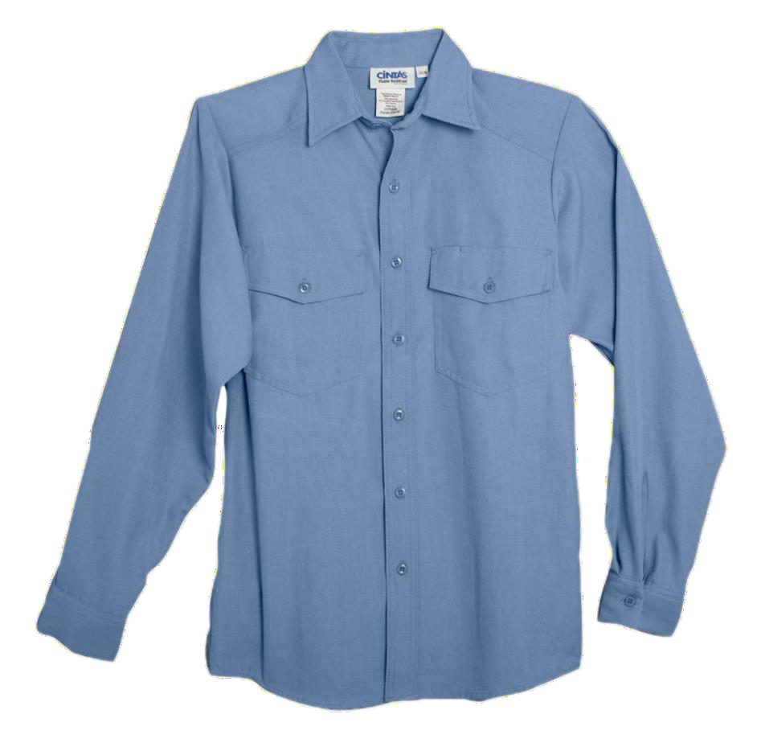





MASON STYLE
Workshirt SS/LS
022935 (20) Navy, (30) Grey
Nomex Essentials Shirt
000656 (20) Navy, (60) Khaki, (80) Light Blue
65% polyester/35% cotton
80% polyester/20% cotton poplin
Vented back panel for increased breathability for temperature regulation, Stretch and mobility, Pencil stall at left check pocket, ComfortFLEX, Imported
Rental Ready, 4.5 oz. NOMEX® LLLA SHIRT
Women's XS-4XL, Machine Wash
Unisex S-XL, 2XL-5XL, Machine Wash
(20)
(30)
(60)
(80)

Slide 25
















MASON STYLE
The Comfort Shirt Work Shirt LS
000935 (16) Burgundy, (20) Navy, (21) White/Blue Stripe, (22) Navy/Blue Slate,
(19) Dark Blue, (25) Blue/ White Checkered, (24) Hunter Green/Navy, (31)White/Charcoal Stripe, (38) Charcoal/Blue Stripe, (80) Light Blue,
(30) Light Grey, (33) Charcoal, (60) Tan, (63) Tan Mini Pattern, (00) White
The Comfort Shirt Work Shirt SS
000935 (16) Burgundy, (20) Navy, (21) White/Blue Stripe, (22) Navy/Blue Slate,
(19) Dark Blue, (25) Blue/ White Checkered, (24) Hunter Green/Navy,
(31)White/Charcoal Stripe, (38) Charcoal/Blue Stripe, (80) Light Blue,
(30) Light Grey, (33) Charcoal, (60) Tan, (63) Tan Mini Pattern, (00) White
65% polyester/35% cotton Cintas ComfortFLEX® fabric
65% polyester/35% cotton Cintas ComfortFLEX® fabric
(00) (16) (19) (20) (21)
(22) (24) (25) (30) (33)
Lightweight work shirt allow for flexibility and has 11% stretch, Imported/Domestic
Lightweight work shirt allow for flexibility and has 11%
stretch, Imported/Domestic
Men’s Long-Sleeve S-XL, 2XL-4XL* Men’s Short-Sleeve S-XL, 2XL-4XL* Machine Wash
Men’s Long-Sleeve S-XL, 2XL-4XL* Men’s Short-Sleeve S-XL, 2XL-4XL* Machine Wash
(60) (63) (80)

Slide 26




Action Back Shirt
SHORT SLEEVE 116930 (33) Charcoal
LONG SLEEVE 116931 (33) Charcoal
65% polyester/35% cotton
Poplin fabric with soil release, Action back construction with ventilation reinforces shoulder seams, Button down collar, Upper left chest pocket, Button front placket
Unisex XXS-6XL, Machine Wash
(33)

Slide 27












MASON STYLE
Moisture Management Polo – Men’s
61581 (44) Forest, (35) Black, (33) Carbon,
(26) Royal, (20) Navy, (15) Red,
(00) White
Moisture Management Polo – Women’s
61582 (33) Carbon, (35) Black, (26) Royal, (20)
Navy, (15) Red
Pocket Knit Polo (Moisture Management)
62157 (20) Classic Navy, (26) Royal, (33) Carbon, (35) Black
4.1 oz 100% polyester pique
Pocket version of the popular 061581 polo, Moisture wicking, Anti-microbial and UV protection performance for all day comfort, Heat-sealed label for comfort, Imported
Men's S-5XL, Machine Wash
4.1 oz 100% polyester pique
4.1 oz 100% polyester pique
Feminine cut made specifically for a woman's
figure, Moisture management to keep cool and dry, UV protection and antimicrobial properties, Imported
Moisture management to keep cool and dry, UV protection and antimicrobial properties, Imported
Misses’ XS-3XL, Machine Wash
Men’s Regular S-5XL, Long L-5XL, Machine Wash
(00)
(15)
(20)
(26)
(33)
(35)
(44)

Slide 28

MASON STYLE
Comfort Flex Pro Work Pant (F)
023390 (20) Navy, (35) Black, (62) Khaki
Comfort Flex Pro Work Pant (M)
023945 (20) Navy, (33) Charcoal, (62) Khaki
Comfort Flex Pro Cargo Pant (F)
023389 (20) Navy, (35) Black, (62) Khaki
Comfort Flex Pro Cargo Pant (M)
023270 (20) Navy, (35) Black, (33) Charcoal, (62) Khaki
42% stretch polyester/36% bi- components/22% cotton
51% polyester/27% cotton canvas/22% polyester stretch
51% polyester/27% cotton canvas/22% polyester stretch
51% polyester/27% cotton canvas/22% polyester stretch
Interior stretch waistband for added mobility and comfort, Spacious pockets including a cell phone pocket on right leg, Gusset providing additional mobility and comfort
Stretch canvas, Durable, Lightweight, Breathable and allows for increased movement & comfort, Interior stretch waistband: Comfort and ease of movement at waist; interior only, so it is not seen from the outside, Cargo pockets
Stretch canvas, Durable, Lightweight, Breathable and allows for increased movement & comfort, 20% stretch and full recovery in a lighter weight fabric, Interior stretch waistband – comfort and east of movement of waist, Cargo pockets, Updated modern fit
Stretch twill – lightweight, breathable and allows for increased movement & comfort, interior stretch waistband – a soft-feel elastic waistband for added comfort & mobility, back welt pockets, mid-rise waist, straight leg
Men's 29-52, Machine Wash
Women’s 0-36, Machine Wash
Men's 29-52, Machine Wash
Women’s 0-38, Machine Wash
(20) (33) (35) (62)

Slide 29

MASON STYLE
The Comfort Pant
000945 (00) White, (20) Navy, (33) Charcoal, (35) Black,
(40) Spruce Green, (50) Brown, (62) Khaki
The Comfort Pant Pleated
000865 (20) Navy, (33) Charcoal, (35) Black, (62) Khaki
65% polyester/35% cotton Cintas ComfortFLEX®
65% polyester/35% cotton Cintas ComfortFLEX®
Relaxed, roomy cut for ultimate for ultimate comfort,
Imported/Domestic
Relaxed, roomy cut for ultimate for ultimate comfort, Imported/Domestic
Men's 26-70, Machine Wash
Men's 26-70, Machine Wash
(00) (20) (33) (35)
(40)
(50)
(62)

Slide 30

30

Slide 31





Active Colorblock Soft Shell Jacket
118442 (21) Navy, (35) Black SAN MAR J718
100% polyester knit shell bonded to a water-resistant film insert and a 100%
polyester mesh interior
1000MM fabric waterproof rating, 1000G/M2 fabric breathability rating, Full- length interior storm flap with chin guard, Reverse coil center
front zipper, Front zippered pockets, Elastic binding at cuffs, Open hem with adjustable lo cking drawcord
Men’s XS-4XL, Machine Wash
(21)
(35)

Slide 32






Fleece Quarter Zip – Men's
117726 (33) Charcoal, (20) Navy
94% polyester/6% spandex
Pullover fleece, Quarter zip with reflective zipper, Stand collar, Front and back v ertical panel seams, Raglan long sleeves, Straight bottom hem
Men’s S-5XL, Machine Wash
Fleece Quarter Zip – Women's
117727 (33) Charcoal, (20) Navy
94% polyester/6% spandex
Pullover fleece, Quarter zip with reflective zipper, Stand collar, Front and back v ertical panel seams, Raglan long sleeves, Straight front hem, Curved back hem
Misses’ XS-XL, Women’s 1XW-3XW, Machine Wash
(20)
(30)

Slide 33




Zip-Off Sleeve Soft Shell Jacket
70899 (33) Charcoal
CORE PRODUCT
Face: 88% polyester/12% spandex, Back: 100% polyester
Water resistant, Stretch polyester, Full-zip front with chin guard,
Backed with soft microfleece, Two lower front vertical zipper pockets and two inner patch pockets, Upper right chest vertical zipper pocket, Zip-off removable long sleeves, Stretch binding at sleeve cuffs, Curved back tail hem, Imported
Unisex XS-XL, 2XL-4XL, Machine Wash
(33)

Slide 34

34

Slide 35






Food and Beverage Options: Aiden, VIB and Premier

Slide 36


Food and Beverage Options: Glo

Slide 37



Apron Options
CORE PRODUCT

