Slide 1


HOTEL UNIFORM IDEAS for BWH Extended Stay Brands

Slide 2
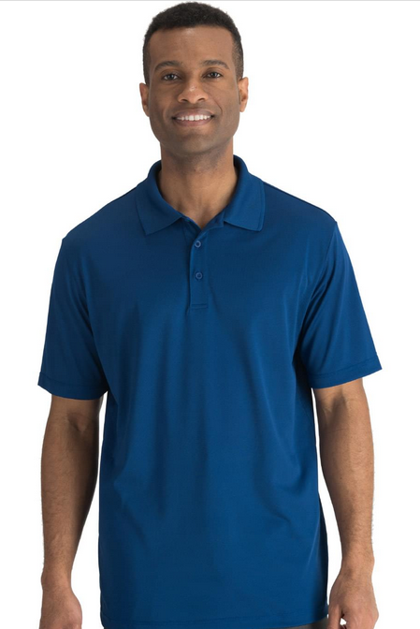
Polos
Good
  Mini-Pique Snag Proof Polo
  Men's Mini-pique polo has a soft hand, is snag-proof and fits your budget. The fabric wicks moisture and is recommended for home launder. Decorates well.
  100% Polyester Snag-Proof Mini Pique, 4.7 oz. wt
  3-Button placket with DTM buttons
  Rib-knit collar and tagless collar
  Straight, hemmed bottom and sleeves
  Moisture wicking

Slide 3
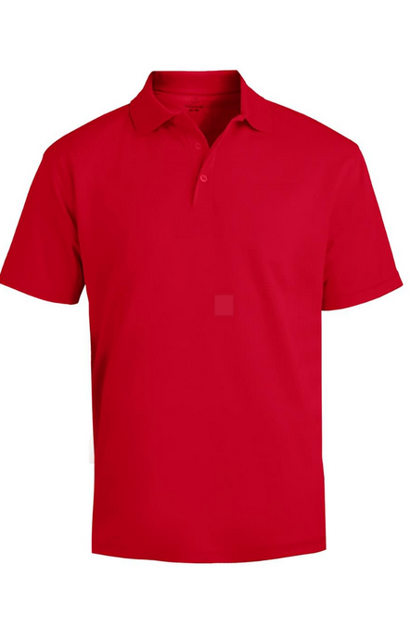

Polos
Better
  High Performance Mesh Polo
  This hi-performance mesh polo wicks moisture and blocks harmful UV rays with UV Protection. Perfect for special events or hardworking image apparel programs. Embroiders well.
  100% Polyester; 4 oz wt
  Short sleeve mesh weave polo wicks moisture
  Three button placket; side vent and contrasting neck tape
  Lightweight fabric with an antimicrobial shield and soil release
  Snag; fade, shrink & wrinkle resistant

Slide 4
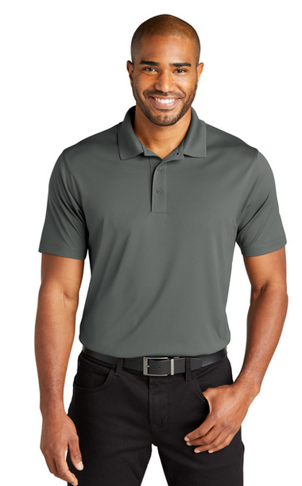
Polos
Best
  C-FREE Performance Polo
  Our recycled pique polo is made of certified recycled materials—from the recycled poly pique fabric to the thread. With a smooth hand, snag-resistance, moisture-wicking and UV protection, this polo performs while making a lower environmental impact.
  3.8-ounce, 100% recycled polyester pique
  Recycled thread
  Snag; fade, shrink & wrinkle resistant
  Moisture wicking
  Side vents

Slide 5
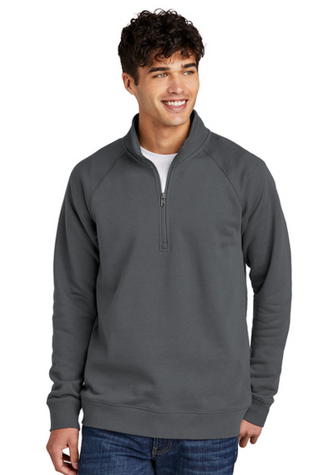
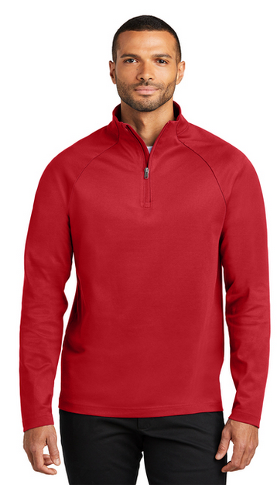
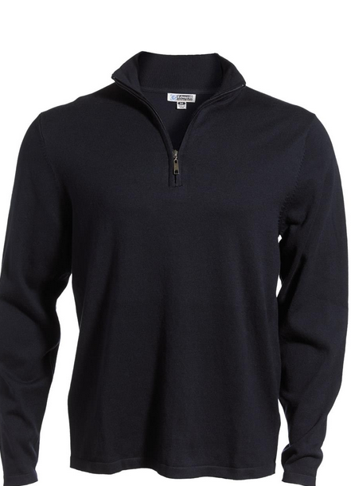
¼ Zip Pullovers & Sweaters
Drive Fleece ¼ Zip
7.5-ounce, 60/40 cotton/poly fleece
Cadet collar
C-FREE® Cypress 1/4-Zip
6.9-ounce, 56% recycled polyester/44% cotton double knit
Cotton Blend ¼ Zip
53% Cotton/24% Nylon/23% Acrylic

Slide 6
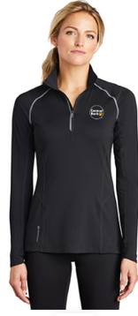
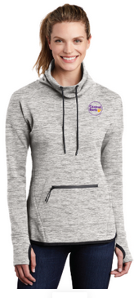
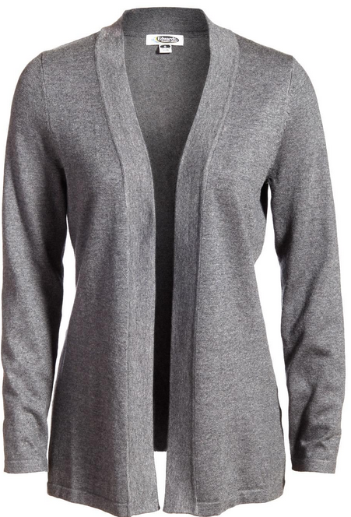
¼ Zip Pullovers & Sweaters
Nexus ¼ Zip Pullover
Cowl Neck Pullover
Open Cotton Cardigan Sweater

Slide 7
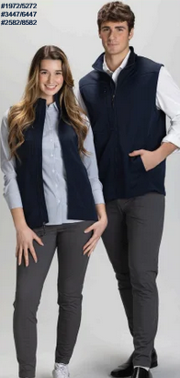
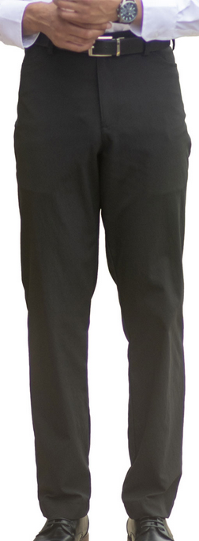
Pants
Flex Dress Pant-Slim
Flex Chino Pant

Slide 8
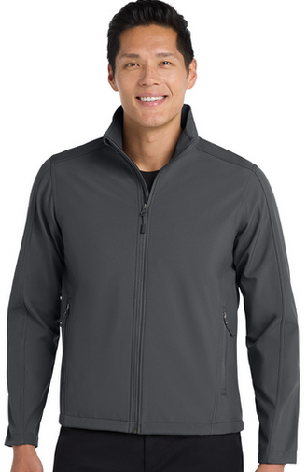
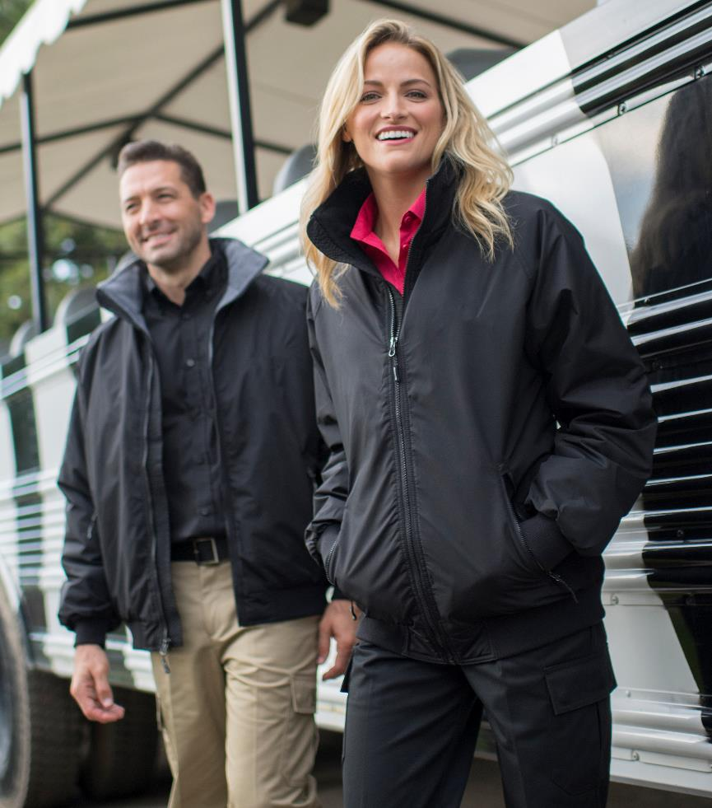
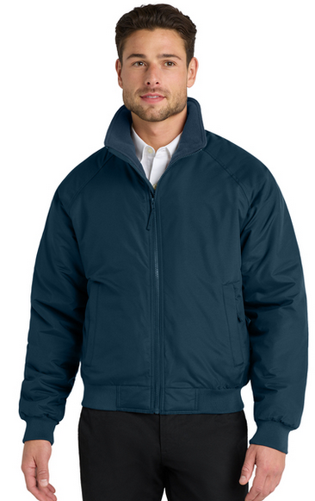
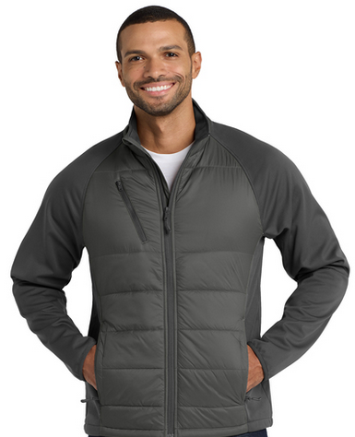
Outerwear

